Slide 1
Software Engineering MY Private Vaccine: A Web Based Private Covid-19 Vaccination System
By:
Ni Putu Zara Athifa Wijana (E1800193)
Muthia Kartika Putri (E1800189)
Notes:
jsjsjsjsjsj

Slide 2
Objectives
Helping private healthcare to record and monitor the number of patients who will carry out vaccinations.
Helping private healthcare to send data on patient recipients of vaccines to the database of the national vaccine committee
Helping the general public to carry out self-vaccination and can make it easier for them to choose the type of vaccine to be used.

Slide 3
TABLE OF CONTENTS
01.
USE CASE DIAGRAM
02.
DEMONSTRATION 1
03.
GANTT CHART
04.
GIT HUB
You can describe the topic of the section here
You can describe the topic of the section here
You can describe the topic of the section here
You can describe the topic of the section here

Slide 4
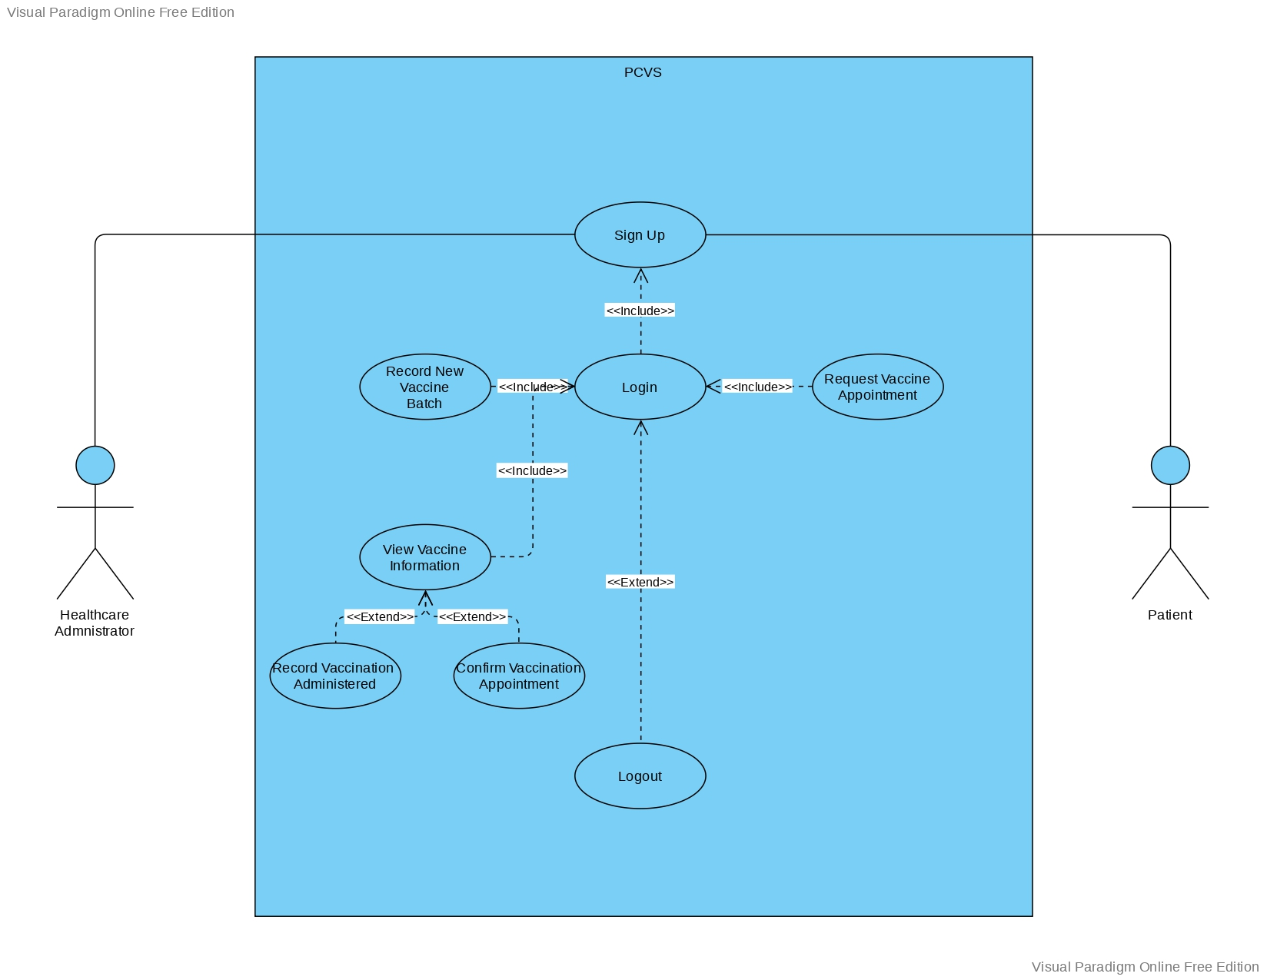
Use Case Diagram

Slide 5
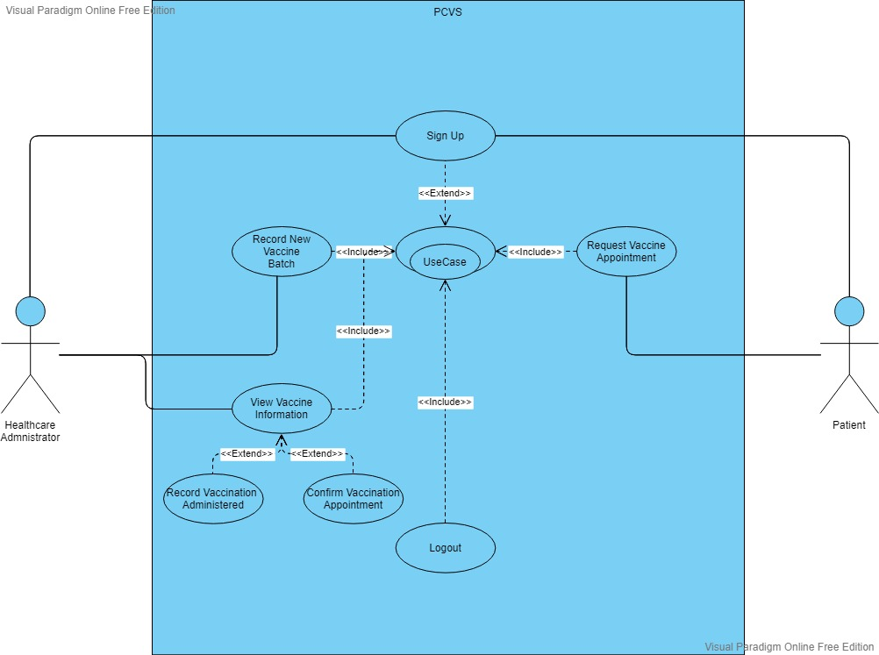
Use Case Diagram

Slide 6
Division of Work
Iteration 1
No. | Use Case | Develop by
1. | Sign Up | Ni Putu Zara Athifa Wijana
2. | Login | Ni Putu Zara Athifa Wijana
3. | Logout | Ni Putu Zara Athifa Wijana

Slide 7
Division of Work
Iteration 2
No. | Use Case | Develop by
1. | Request vaccine appointment | Ni Putu Zara Athifa Wijana
2. | Record new vaccine batch | Ni Putu Zara Athifa Wijana
3. | View vaccine information | Muthia Kartika Putri
4. | Record vaccination administered | Muthia Kartika Putri
5. | Confirm vaccination appointment | Muthia Kartika Putri

Slide 8
Live Demonstration

Slide 9
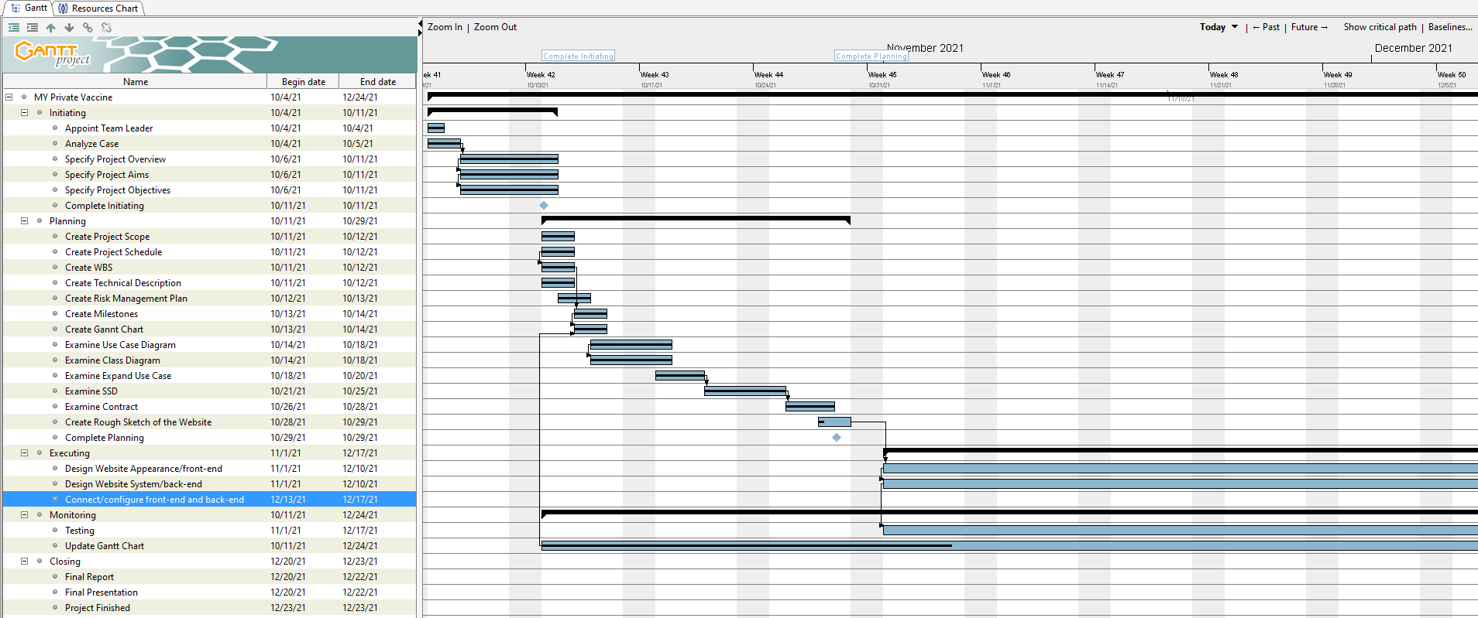
Gantt Chart

Slide 10
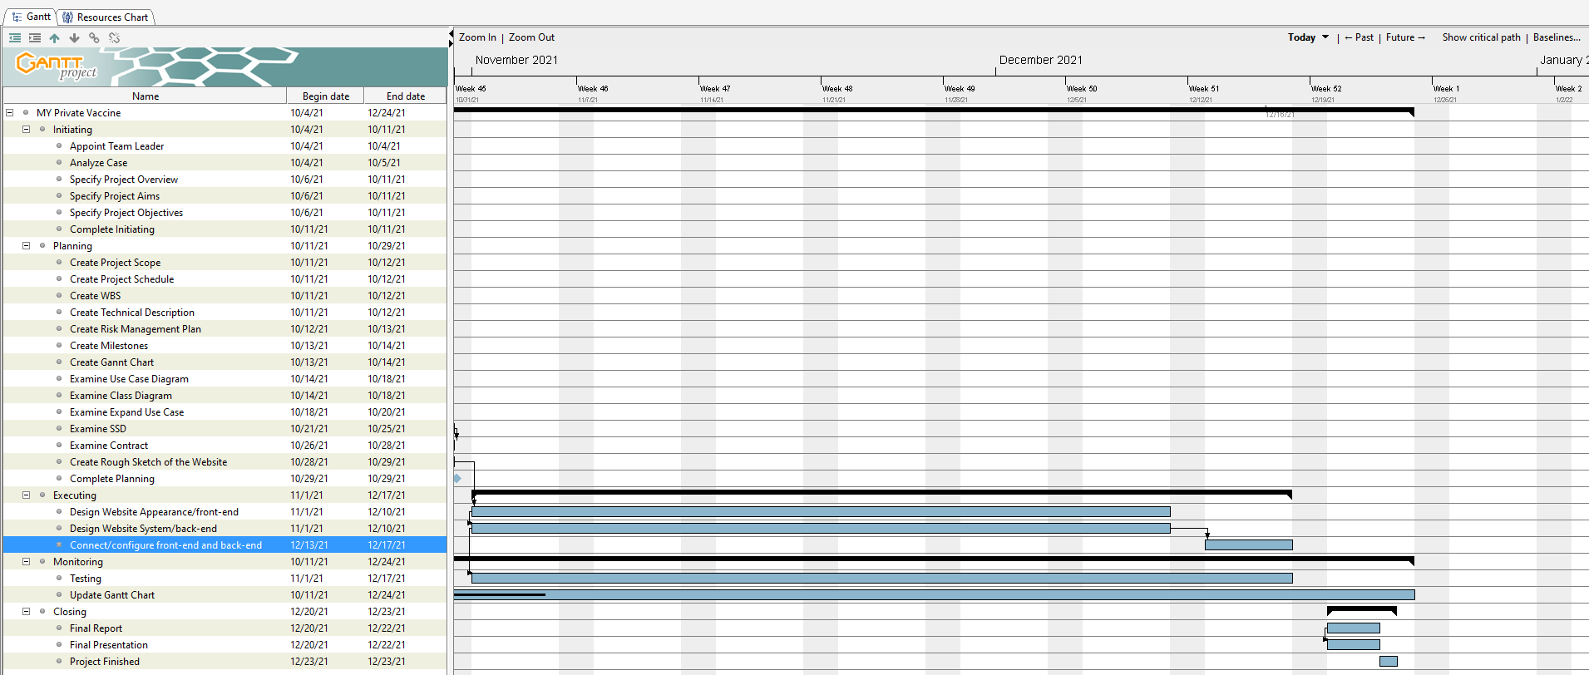
Gantt Chart

Slide 11
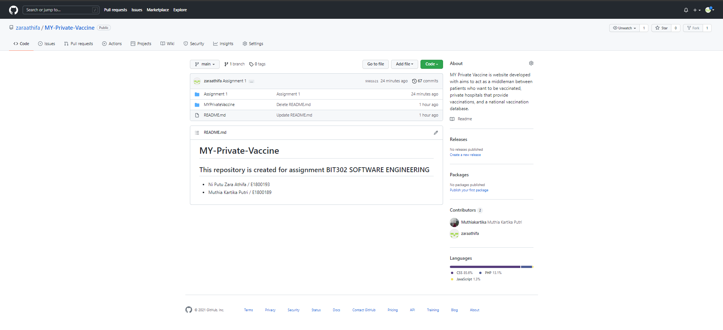
Git Hub

Slide 12
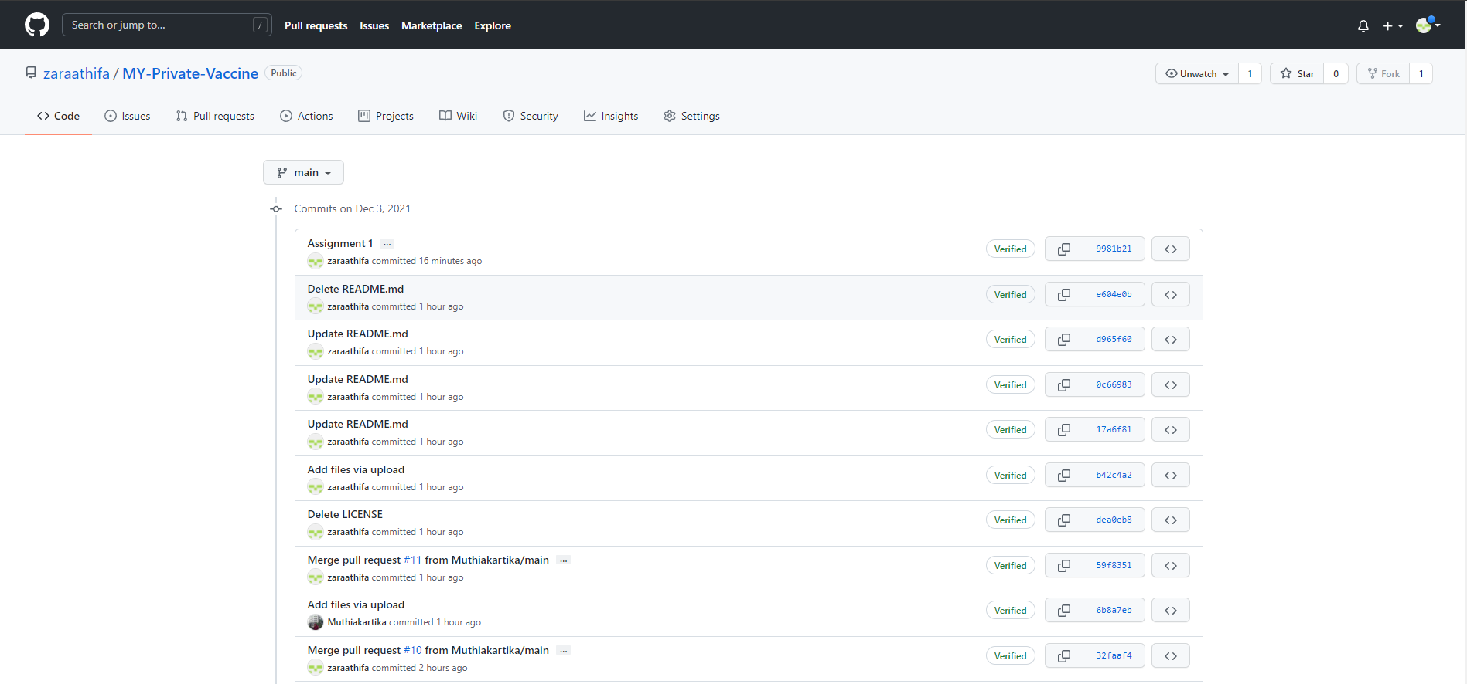
Git Hub

Slide 13
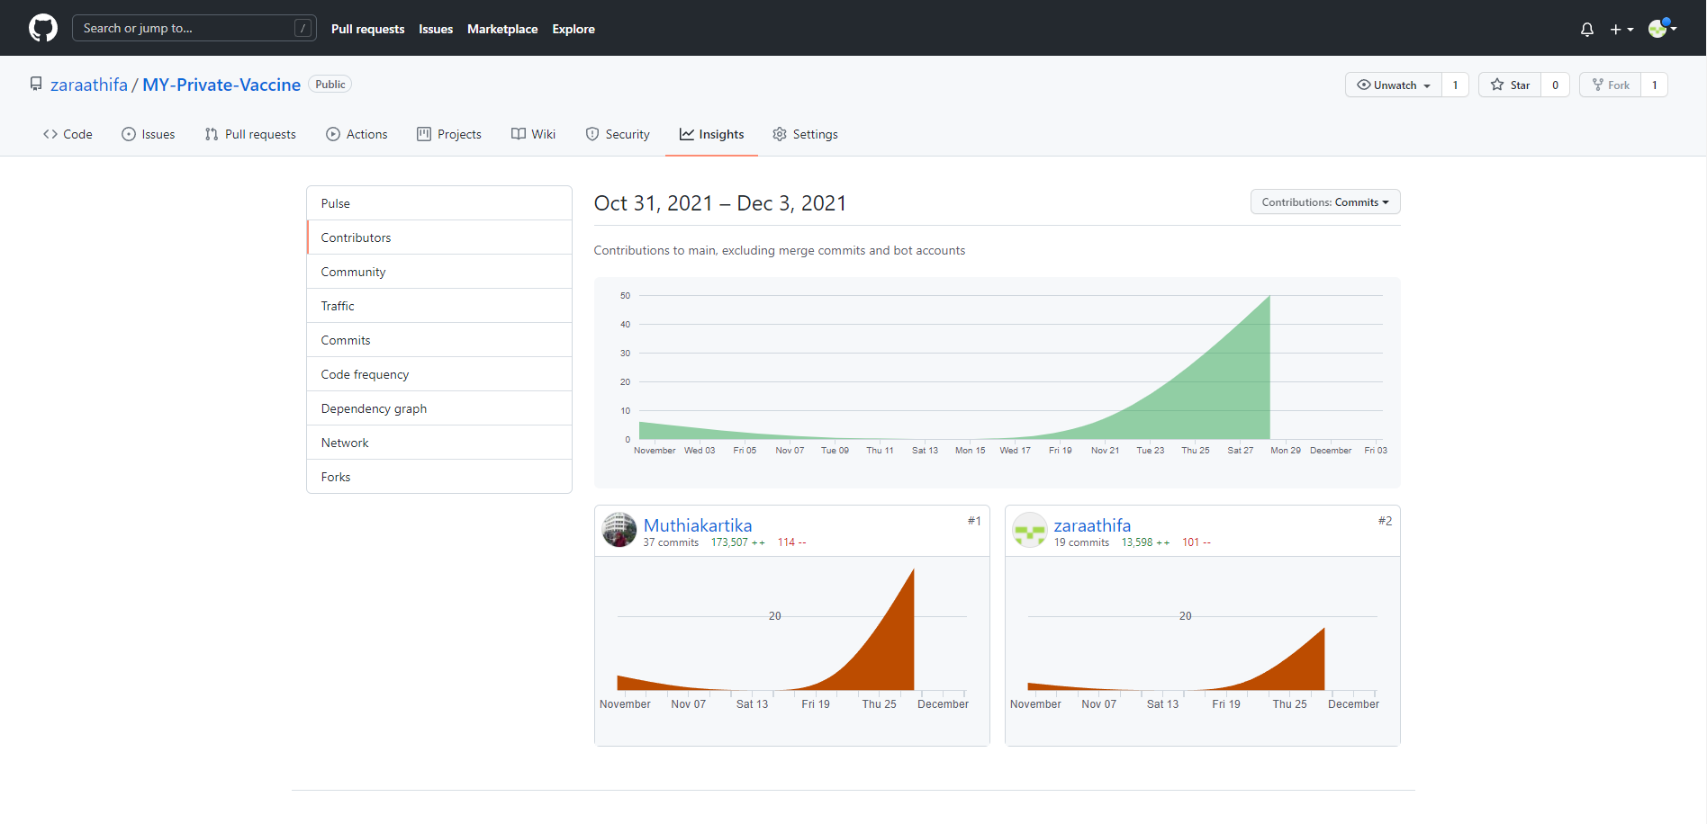
Git Hub

Slide 14
Thank You

